Slide 1
Control Engineering
Lecture 12

Slide 2
Dead Time Compensation – Smith Predictor
Effects of Dead-Time (Time Delay):
  Process with large dead time (relative to the time constant of the process) are difficult to control by pure feedback alone:
      Effect of disturbances is not seen by controller for a while
      Effect of control action is not seen at the output for a while. This causes controller to take additional compensation unnecessary
      This results in a loop that has inherently built in limitations to control

Slide 3
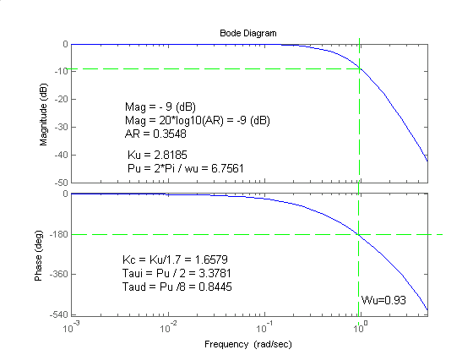
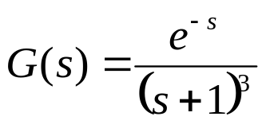
Example – A Bode Plot Example
h=tf(1,[1 3 3 1],'inputdelay',1);

Slide 4
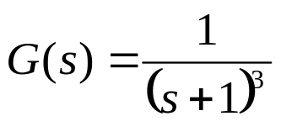
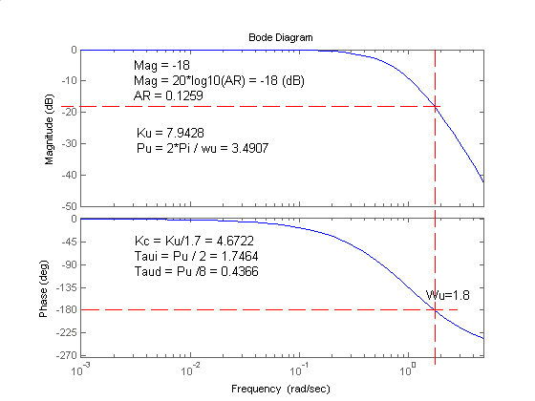
Example- continued, case without time delay

Slide 5
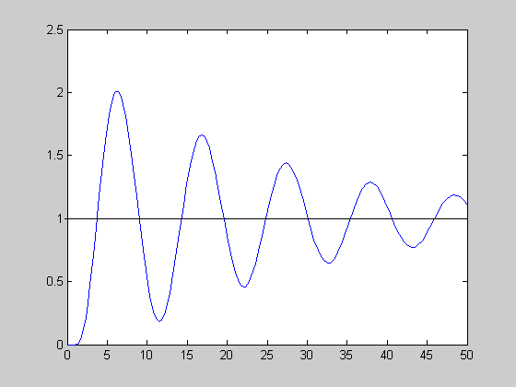
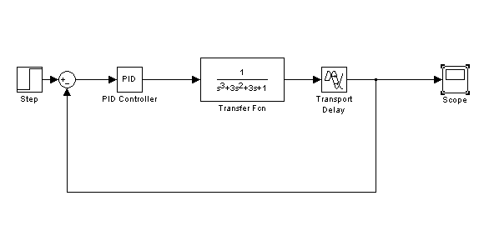
PID Control Results- Case with delay (Kp=1,Ki=1,Kd=1)

Slide 6
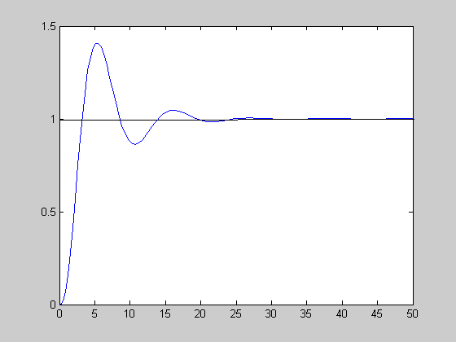
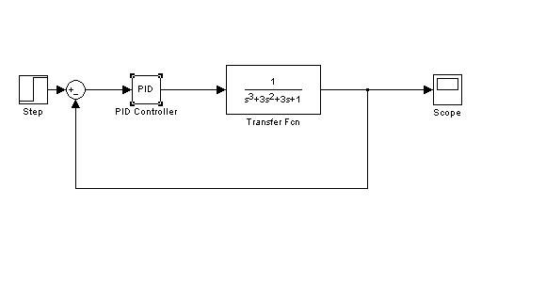
PID Control Results- Case without delay (Kp=1,Ki=1,Kd=1)

Slide 7
Causes of Dead-Time
Transportation lag (long pipelines)
Sampling downstream of the process
Slow measuring device
Large number of first-order time constants in series (e.g. distillation column)
Sampling delays introduced by computer control

Slide 8













The Smith Predictor
Process
Controller
＋
－
Controller mechanism
Process
Controller
＋
－
Dead-time compensator
＋
＋

Slide 9

The Smith Predictor
Controller mechanism
Process
Controller
＋
－
Dead-time compensator
＋
＋
Process
Controller
＋
－

Slide 10
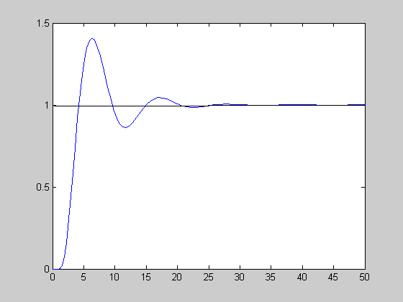
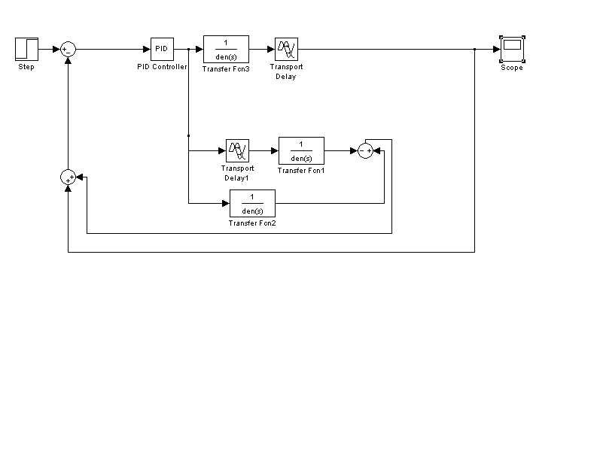
Control with Smith Predictor: (Kp=1,Ki=1,Kd=1)

Slide 11




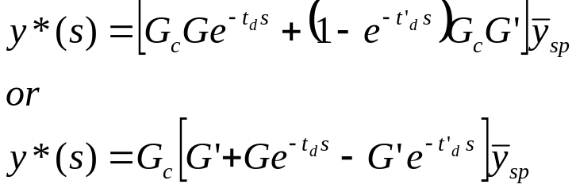
The Effect of Modeling Error
Controller mechanism
Process
+
G_{c}(s)
G(s)
e^{-tds}
-
+
(1-e^{-td’s})G’(s)
-
Errors in td’,G’ both cause the control system to degrade

Slide 12
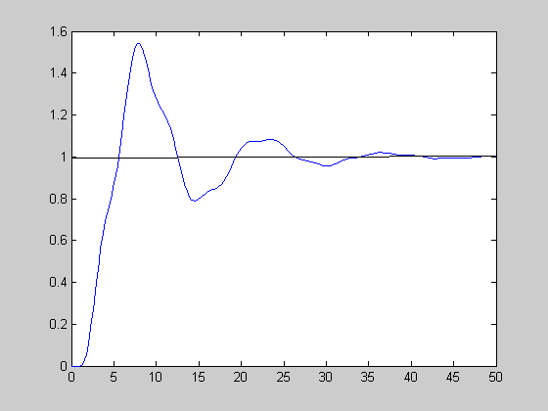
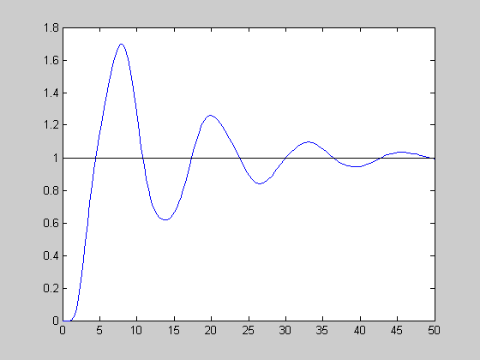
Smith Predictor with Modeling Error
Plant=e^{-s}/(s³+3s²+3s+1)
Model=e^{-s}/(s³+s²+s+1)
Model=e^{-0.5s}/(s³+s²+s+1)

Slide 13
Analytical Predictor
y_{SP}
G_{C}(s)
G_{P}e^{-DS}
y(s)
Analytical
Predictor
y(t+D)
Analytical Predictor is a model that projects what y will be
D units into the future (on-line model identification)

